Slide 1
Milestone 2
Steven Booth, Peter Harlan, Daniel Monterrosas, Michelle Schapmire, and Zachary Wathen

Slide 2
Introduction
Updated Project Overview and Goals
Updated Requirements
Updated Project Scope
Technical Resources
Use cases
Group's Approach
Progress Visibility
Remaining Duration Assessment
Update risk analysis
Prototype demoi

Slide 3
Updated Project Overview and Goals
Project Overview
Wikipedia is an online encyclopedia with articles created and edited by volunteers around the world. Wikipedia describes itself as the free web-based encyclopedia that anyone can edit. The accessibility and ease of use of the website are integral elements of its growth and popularity. These elements will shape how each feature is developed for the final product. The goal is to create an accessible web-based encyclopedia. The mini WKU themed Wikipedia will be easy to use, which will attract users to create, edit, and explore articles.
Our Client
Our team will be working for a client, Mahn Do, who will direct our building of the mini Wiki from start to finish. Mr. Do will be briefed weekly on the team's development progress, and will be notified and inquired about all major decisions dealing with the Wiki clone project. The Wiki will be built to the specifications and liking of Mr. Do throughout the entire developmental process.

Slide 4
Updated Requirements
Functional
Account Creation
Login
Search
Create Page
Edit Page
Recover Back up Pages
Nonfunctional
Security
Usability
Compatibility

Slide 5
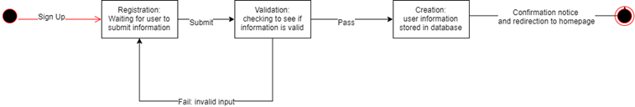
Current Sprint Requirements

Slide 6
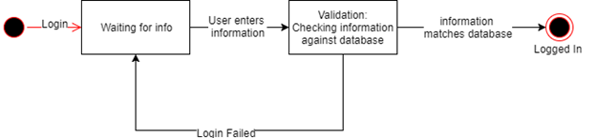
Current Sprint Requirements

Slide 7
Updated Project Scope
Project Task
Create a smaller Version of Wikipedia centered around WKU
Target Users
WKU Students, Faculty, Staff, Alumni
Possible future students interested in WKU
Current Sprint Objective
Create a home page and registration page with working functionality

Slide 8
Technical Resources: Hardware Architecture
Raspberry Pi 3
The PI's hardware design was geared towards simplicity and mobility. You would not use a single PI to operate a traffic intensive service, but with this being a smaller project, the PI is more than what we require.
Quadcore processor
HDMI port
Wifi/Ethernet
Audio Jack
SD card port
Micro USB power
USB ports

Slide 9
Technical Resources: Software Architecture
LAMP
PHPmyAdmin
MySql
PHP/HTML/Javascript
Bootstrap
Docker
Docker Cloud
Github

Slide 10
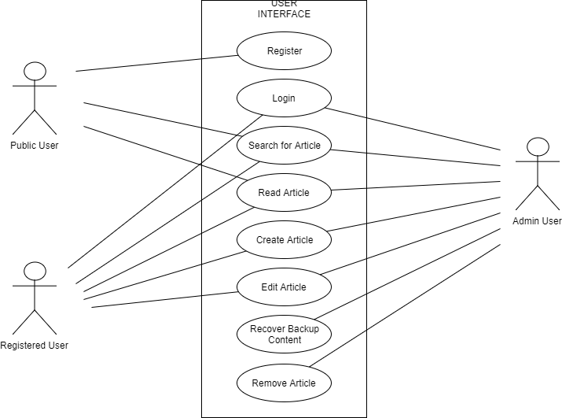
Use Cases
User Interface Interactions

Slide 11
Group Approach
Software Process Model used
How group met, time spent
Gantt Chart/ Activity Graph
Estimated time to complete each task
Progress visibility
Asses remaining duration of the project

Slide 12
How the group met, Time spent
Meeting Time | Meeting Type | Group A | Group B
Monday 6-8:30pm | In Person/Virtual | Yes | No
Tuesday 4-7:00pm | In Person | Yes | Yes
Wednesday 7-9:30pm | In Person/Virtual | No | Yes
Thursday 7-9:00pm | Virtual | Yes | Yes
Friday 11:30-12:25pm | In Person Client Meeting | Yes | Yes

Slide 13
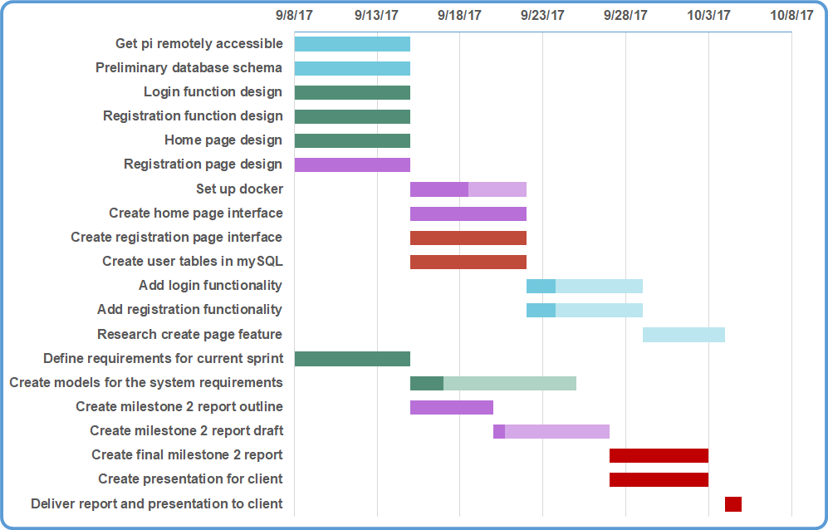

Slide 14
Estimate time to complete tasks
Tools:
Activity Key Chart
Activity Graph

Slide 15
Task Label | Description | Personnel | Required Resources | Task dependency | HoursEst.
A | Set up remote access on the pi | Zach | Raspberry Pi SSH access PutTy |  | 4
B | Define requirements for sprint | Team Client |  |  | 2
C | Plan Timeline | MIchelle | Team input | B | 2
D | Design home page and registration page | Peter Steven |  |  | 5
E | Create home page and registration page | Peter Steven | Html, css, javascript, bootstrap | A, D | 10
F | Create a database design | Daniel Zach |  |  | 2
G | Create database and accounts table | Daniel | Phpmyadmin, MySQL | A | 2

Slide 16
H | Add login and registration functionality | Zach Steven | PHP, Apache, MySQL, Javascript | D,G | 10
I | Set up Docker and package the web interface | Michelle | Docker, Docker Cloud, SSH | A, H | 10
J | Create models for system requirements | Michelle Daniel |  | B | 3
K | Create outline for milestone 2 documentation | Peter Michelle |  |  | 2
L | Create 25 page draft of documentation | Team |  | K | 10
M | Create final report for milestone 2 | Team |  | L | 8
N | Create presentation | Team |  | M | 2

Slide 17
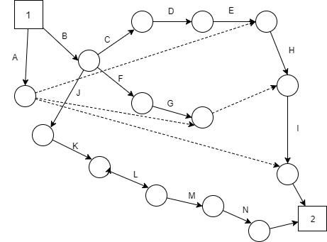
Activity Graph

Slide 18
Progress Visibility

Slide 19
Task Name | Start Date (2017) | End Date (2017) | Duration (Days) | Days Complete | Days Remaining | Percent Complete
Get pi Remotely Accessible | Sept 8 | Sept 15 | 7 | 7.00 | 0.00 | 100%
Preliminary Database Schema | Sept 8 | Sept 15 | 7 | 7.00 | 0.00 | 100%
Login Function Design | Sept 8 | Sept 15 | 7 | 7.00 | 0.00 | 100%
Registration Function Design | Sept 8 | Sept 15 | 7 | 7.00 | 0.00 | 100%
Home Page Design | Sept 8 | Sept 15 | 7 | 7.00 | 0.00 | 100%
Registration Page Design | Sept 8 | Sept 15 | 7 | 7.00 | 0.00 | 100%
Set Up Docker | Sept 15 | Sept 22 | 7 | 7.00 | 0.00 | 100%
Create Home Page Interface | Sept 15 | Sept 22 | 7 | 7.00 | 0.00 | 100%
Create Registration Page Interface | Sept 15 | Sept 22 | 7 | 7.00 | 0.00 | 100%
Create User Tables in mySQL | Sept 15 | Sept 22 | 7 | 7.00 | 0.00 | 100%
Add Login Functionality | Sept 22 | Sept 29 | 7 | 7.00 | 0.00 | 100%
Add Registration Functionality | Sept 22 | Sept 29 | 7 | 7.00 | 0.00 | 100%
Research Create Page Feature | Sept 29 | Oct 4 | 5 | 5.00 | 0.00 | 100%

Slide 20
Define Requirements for Current Sprint* | Sept 8 | Sept 15 | 7 | 7.00 | 0.00 | 100%
Create Models for the System Requirements* | Sept 15 | Sept 25 | 10 | 10.00 | 0.00 | 100%
Create Milestone 2 Report Outline* | Sept 15 | Sept 20 | 5 | 5.00 | 0.00 | 100%
Create Milestone 2 Report Draft* | Sept 20 | Sept 27 | 7 | 7.00 | 0.00 | 100%
Create Final Milestone 2 Report* | Sept 27 | Oct 3 | 6 | 6.00 | 0.00 | 100%
Create Presentation for Client* | Sept 27 | Oct 3 | 6 | 6.00 | 0.00 | 100%
Deliver Report and Presentation to Client* | Oct 4 | Oct 5 | 1 | 1.00 | 0.00 | 100%

Slide 21
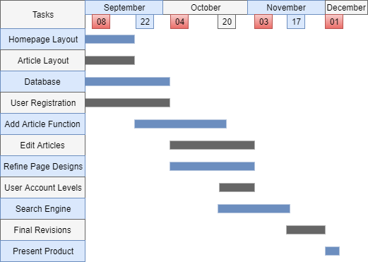
Remaining Duration Assessment

Slide 22
Updated Risk Analysis
Operational risks
Lack experience with docker
Technical Risks
Pi malfunctioning
Connectivity to the pi
Time management and communication crucial to preventing risks from becoming a problem

Slide 23
Project Prototype Demo

